Slide 1
Reading Apprenticeship (RA)
Par Mohammadian, Life Science Faculty
Spring to Spring Day
Los Angeles Mission College, Spring 2016

Slide 2
Questions?
How many of you believe that your students don’t read their textbooks?
How many of you believe that students don’t read their textbooks correctly?

Slide 3
Question?
What do you do to
help/motivate/encourage/teach students
to read their textbooks?

Slide 4
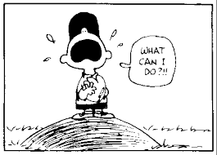

Slide 5
Introduction to RA by WestEd (Oakland, CA)
Mission:
WestEd — a nonprofit research, development, and service agency — works with education and other communities to promote excellence and improve learning.

Slide 6
“RA is an approach to reading instruction that helps students develop the knowledge and strategies
to become more powerful readers.”
Students become better readers by
Engagement
Making knowledge visible
Helping students gain insight into their own reading processes
Helping the students to develop strategies to overcome obstacles & deepen their comprehension of texts from various academic disciplines.
Reading for Understanding by Schoenbach & Greenleaf & Murphy

Slide 7
What Is Reading?
Reading is just a basic skill.
Reading is a skill that is taught once in the first few years of school.
Reading is a simple process: Readers decode (figure out how to pronounce) each word & then automatically comprehend the meaning.
This is not our understanding of reading.
Reading for Understanding by Schoenbach & Greenleaf & Murphy

Slide 8
Reading is a complex process.
Reading is problem solving.
Fluent reading is not the same as decoding.
Reading proficiency varies with situation and experience.
Proficient readers share some key characteristics.
Reading for Understanding by Schoenbach & Greenleaf & Murphy

Slide 9
Reading is a complex process.
Experienced readers
generate a mental representation of the text.
test, monitor, and analyze their understanding as they interact with the text.
Reading for Understanding by Schoenbach & Greenleaf & Murphy

Slide 10
Reading is problem solving.
Reading is not a straightforward process of lifting the words off the page.
Reading is a complex process of problem solving - - -
the reader works to make sense of a text
not just from the words and sentences on the page
but also from the ideas, memories, and knowledge
evoked by those words and sentences.
Reading for Understanding by Schoenbach & Greenleaf & Murphy

Slide 11
Fluent reading is not the same as decoding.
Skillful reading requires us to read in an automatic manner.
Decoding skills—quick word recognition and ready knowledge of relevant vocabulary, for example—are important to successful reading.
However, they are by no means sufficient,
especially when texts are complex or otherwise challenging.
Reading for Understanding by Schoenbach & Greenleaf & Murphy

Slide 12
Reading proficiency varies with situation and experience.
Social purposes & the experiences:
A mathematics teacher ---- make sense of a metaphor in a poem.
A nursing student great in anatomical diagrams ---- read a legal brief.
An English literature professor ---- comprehend her son’s chemistry text.
A chemistry teacher ---- history colleague’s course reading list.
Reading for Understanding by Schoenbach & Greenleaf & Murphy

Slide 13
Proficient readers share some key characteristics.
Good readers are
• Mentally engaged
• Motivated to read & learn
• Persistent when facing challenge
Reading for Understanding by Schoenbach & Greenleaf & Murphy

Slide 14
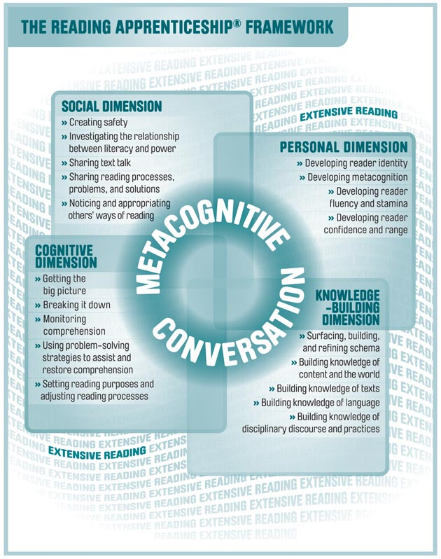
Reading for Understanding by Schoenbach & Greenleaf & Murphy

Slide 15
Social Dimension Peer-interaction & larger social and cultural issues
Classroom activities that help establish a safe culture
Discuss what makes it safe or unsafe for students to ask questions or show their confusion in class.
Agree on classroom rules --- all students can share their ideas & confusions without being made to feel stupid or uncool.
Community building in the classroom
Reading for Understanding by Schoenbach & Greenleaf & Murphy

Slide 16
Social Dimension – cont.
Peer-interaction & larger social and cultural issues
Talk about what is confusing in texts.
Share how other students deal with problems & the ways they think out loud & different strategies they use & suggest.
Participate in whole- or small-group problem-solving discussions.
Different kinds of background knowledge and experience readers (teachers and classmates) bring to texts & how that affects the way they interpret what they read.
Reading for Understanding by Schoenbach & Greenleaf & Murphy

Slide 17
Personal Dimension Out-of-school experience, self-awareness, personal goals
Notice what is happening in your mind & where your attention is when reading.
Identify all the different processes going on while you read.
Demonstrate that all readers, including the teacher, are developing readers -> room to grow during a lifetime
Identify the role that effort & that effort pays off in becoming a stronger reader.
Persist in reading even when you are somewhat confused or bored with a text.
Increase patience; celebrate progress.
Reading for Understanding by Schoenbach & Greenleaf & Murphy

Slide 18
Cognitive Dimension Develops mental processes & Strategies to problem-solving
Getting the big picture, develop strategies such as skimming, scanning, and reading ahead
Helping them understand that they do not have to comprehend everything immediately.
Question texts, authors, and yourself about the text.
“Talk” to the text through marginal annotations.
Visualize what is described in the text.
Make meaningful connections between the text and other knowledge, experiences, or texts.
Reread sections of the text to clear up confusions.
Summarize, retell, or paraphrase texts or parts of texts.
Represent concepts and content of texts in graphic form.
Reading for Understanding by Schoenbach & Greenleaf & Murphy

Slide 19
Knowledge-Based Dimension Identifying & expanding knowledge
Identifying & expanding knowledge develop through interaction with text.
Brainstorm & share knowledge.
Identify conflicting knowledge.
Imagine yourself in situations similar to those that will be encountered in the text.
Take positions on a topic before reading about it.
Use the interconections between visuals & text to build comprehension.
Reading for Understanding by Schoenbach & Greenleaf & Murphy

Slide 20
Conclusions
Personal experience
Life science faculty / STEM RA grant
Looking forward to form an RA community on our campus

Slide 21
3CSN events & LAMC

Slide 22
Questions?

